Slide 1

Mismatched training and dev/test data
Addressing data
mismatch
deeplearning.ai

Slide 2
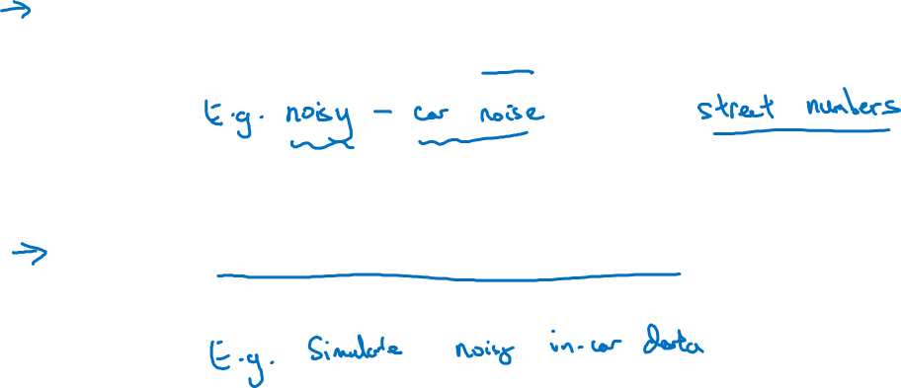
Addressing data mismatch
Carry out manual error analysis to try to understand difference
between training and dev/test sets
Make training data more similar; or collect more data similar to
dev/test sets

Slide 3

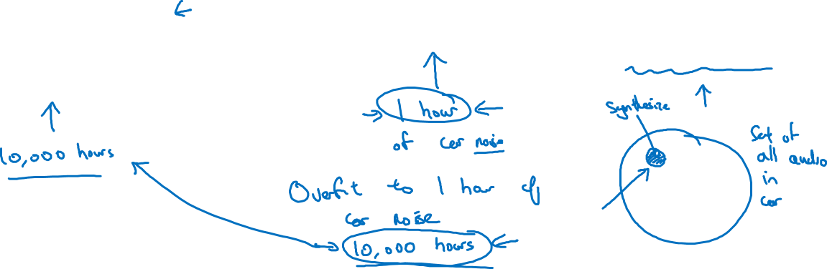
Artificial data synthesis
+
=
“The quick brown fox jumps
over the lazy dog.”
Car noise
Synthesized
in-car audio

Slide 4
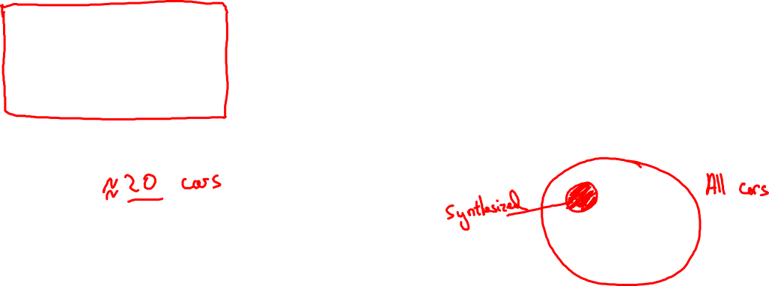
Artificial data synthesis
Car recognition:

